Slide 1
predicting Induced Seismicity in the Eagle Ford Shale play
By: Melissa McMillan
March 4, 2021

Slide 2
outline
Problem Setup
Datasets Used
EDA
Modelling and Results
Conclusions and Future Work
References
Notes:
Here is a brief outline of my presentation

Slide 3
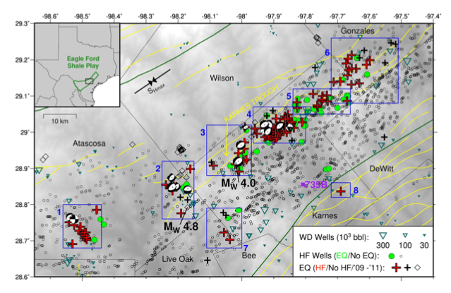
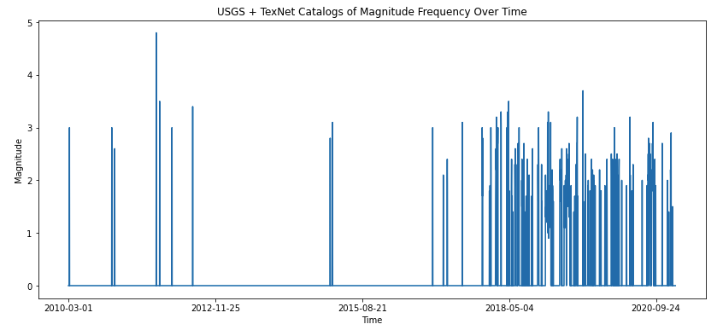
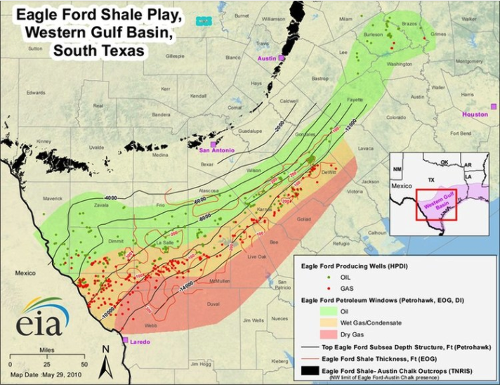
Induced seismicity a problem in 2017+
December 2017
Fasola et al 2019
Eagle Ford Shale Play has been exploited for 20+ years, why the recent uptick in seismicity?
eaglefordshale.com
Notes:
The Eagle Ford Shale Play or Trend is an area in South Texas where oil and gas operators drill into and extract from the world class Eagle Ford Shale. This formation has been producing hydrocarbons for several decades, and in earnest using modern techniques for the last 10-20 years. In recent years, mainly late 2017 onward, there has been an uptick in the number and magnitude of earthquakes, particularly in Karnes County, outlined in red. While a recent publication, Fasola et al 2019, has linked the recent seismicity to oil and gas activity, the exact mechanisms for what is causing the earthquakes are still unknown.

Slide 4
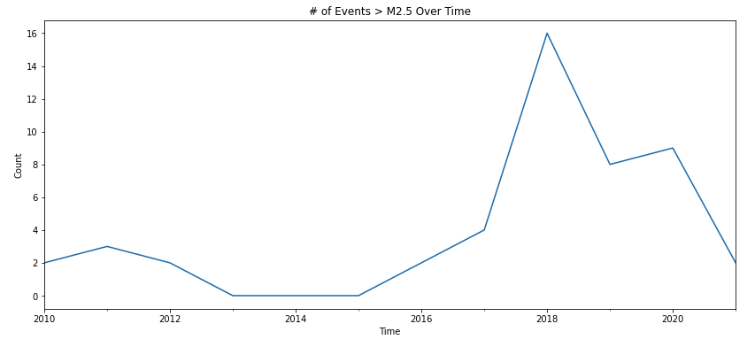
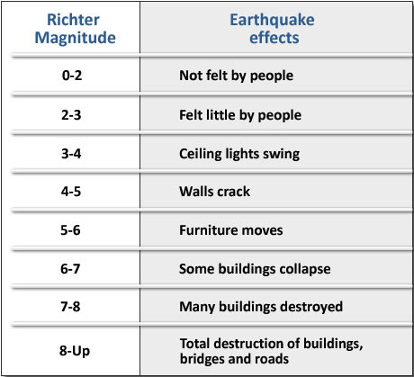
What level of seismicity are we talking?
Eagle Ford Seismicity
EFRD Induced Seismicity
Oklahoma Induced Seismicity
Natural Seismicity (CA, Japan, etc)
https://www.sms-tsunami-warning.com/
Notes:
What kind of seismicity are we talking about here? On the left I have a chart showing the range of how we measure earthquakes, using a Magnitude calculation, which is a measure for the amount of energy released by an event. The Magnitudes range from very small where they aren’t felt at all to very large where significant damage occurs. Natural seismicity occurs every day at a full range of magnitude, most of which aren’t felt. In terms of induced, or human-caused seismicity, Oklahoma has experienced some of the largest induced events in the world, up to ~M6, causing significant damage. For the seismicity examined in this project in the Eagle Ford Shale Trend, we are talking generally much smaller, on the scale of Magnitude 0-3.5 at most, but the size and frequency of events is growing larger, so understanding the drivers is becoming more important.

Slide 5
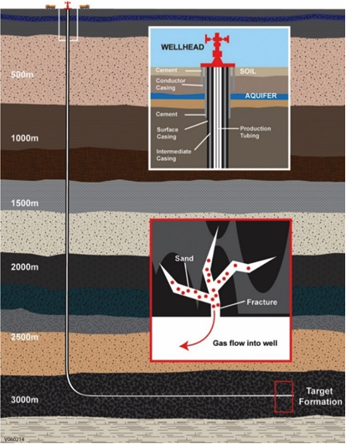
What is a completion?
Frac = ‘Hydraulic Fracture’
Injection of high volumes of water, sand, various chemicals
A way of creating fractures in impermeable rock
Once the rock is broken, operators fill fractures with
Sand (called proppant- props open the fracture)
https://frackinginquiry.wa.gov.au/about-hydraulic-fracture-stimulation
Notes:
In many cases of induced seismicity related to oil and gas activity, the mechanisms are often related to well completions, or fracking, but it’s important to note that this is not always the case (as some induced seismicity is related to water injection related to disposal, not stimulation for production purposes). What is a frac? It is short for Hydraulic Fracutre, and is a technique for creating permeability in otherwise impermeable rock by causing fractures to form. Large volumes of water, sand, and various chemical are injected into the target formation to create these small fractures, so the hydrocarbons can then flow into the well and be produced. When fracking takes place near pre-existing large-scale faults that are critically stressed, earthquakes can be induced.

Slide 6
Problem to solve:
Can we predict the level of seismicity in Karnes County using hydraulic fracturing parameters, levels of overall industry activity, etc?
Notes:
With that information, the problem I’m hoping to address in this project is to predict the seismicity in this trend by using completion parameters as well as indicators of industry activity overall. If we can better understand the key drivers of the induced seismicity, then operators have the opportunity to adjust their completion techniques to mitigate the risk of inducing seismicity.

Slide 7
datasets used
Indicators of Industry Activity:
Rig Count
WTI Spot Price
Brent Spot Price
Completion Parameters:
# Fracs/Day
Volume Water Injected/Day
Volume Water Injected/FT Lateral
Notes:
I used several datasets for this study. The data used as indicators for industry activity were rig count, and the commodity prices of West Texas Intermediate and Brent Crude. The completion parameters obtained were limited to what is publicly reported, such as frac start and stop times, leading to the number of fracs happening per day, and the total volume of water injected. I used a simple assumption of mile long laterals to engineer a feature that measures the volume of water injected/ft of lateral.

Slide 8
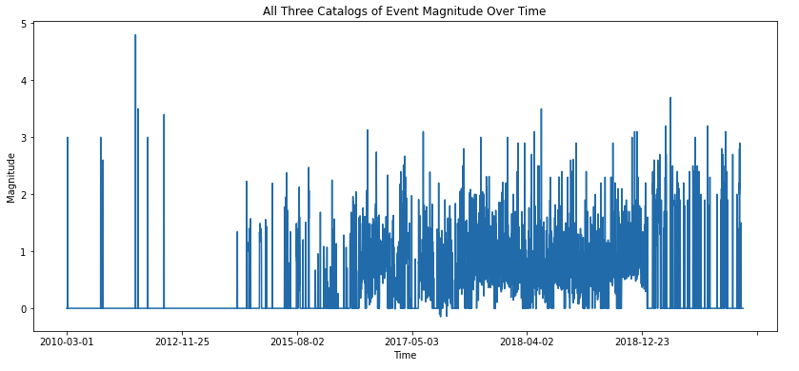
Seismicity data used
Three different catalogs, used for different purposes
USGS catalog: longest running; not high-resolution [historical purpose]
TexNet catalog: implemented early 2017, higher resolution [most recent data]
Fasola et al 2019: enhanced TexNet catalog; March 2014-December 2018 [most detailed]
USGS
Fasola et al
TexNet
Notes:
I tested three different seismicity catalogs for this study, each for various reasons. The USGS catalog has been around the longest, so it is most useful for historical understanding, but is poorest in resolution as the stations are spaced pretty far apart. The Texas Network Array, called TexNet, is the most recent array, and has fairly good resolution, but has only been around since 2017, so it’s not useful for historical purposes. Finally, I was able to obtain the Fasola et al dataset, which utilized the TexNet and one other array, and boosted the catalog using a cross-correlation technique called template matching, which increased the catalog from a few hundred to a couple thousand events, as can be seen in the figure here where the Fasola catalog clearly has the highest number of events. Various combinations of all three catalogs were used for modelling in this project. It is important to note that I needed to be very careful in comparing data using these catalogs, because there are variations between each catalog that might skew observations.

Slide 9
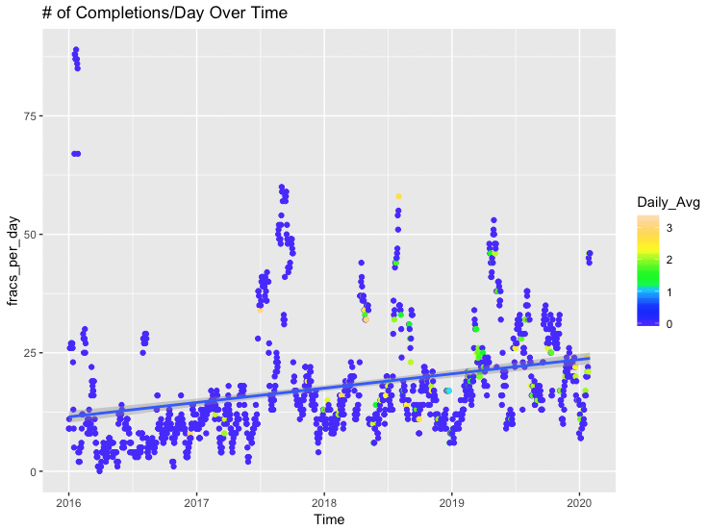
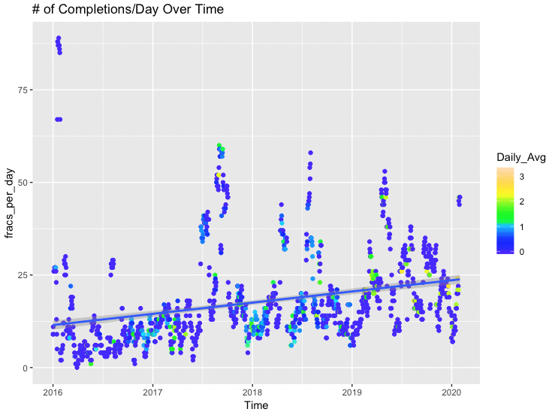
The number of completions/day have increased
USGS + TexNet Dataset
Fasola et al + TexNet Dataset
USGS catalog
TexNet catalog
Fasola catalog
TexNet catalog
Fasola et al catalog has time range 3/2014 - 12/2018

Slide 10
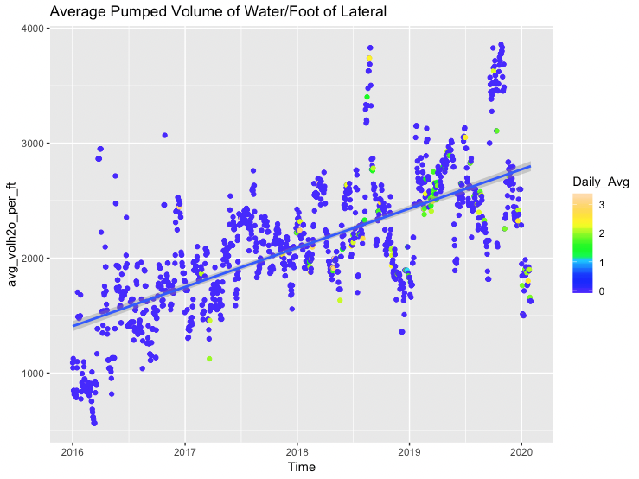
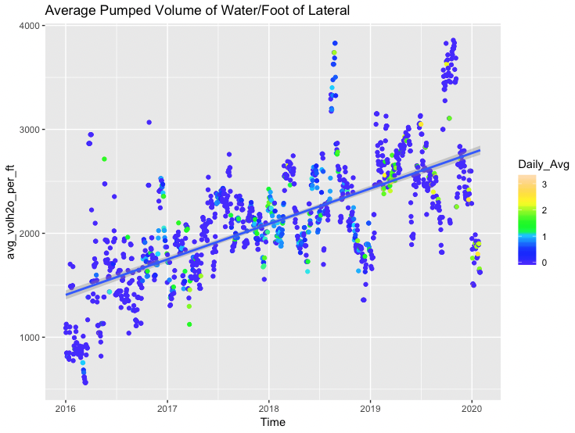
EDA: completions have gotten bigger over time
USGS + TexNet Dataset
Fasola et al + TexNet Dataset
USGS catalog
TexNet catalog
Fasola catalog
TexNet catalog
Fasola et al catalog has time range 3/2014 - 12/2018
Notes:
Now onto EDA, where I looked at many of the features over time and compared them to seismicity. The feature I found most interesting was a comparison of the average volume of water injected/ft of lateral, with data points colored by the daily average size of the earthquake events. In each plot, I show the injection volume per lateral foot over time, the left plot shows seismicity as colored using the USGS/TexNet catalog, while the right shows the same but using the Fasola et al and TexNet combined catalogs. There is a clear increase in the amount of water being injected per lateral foot over time, showing that the completion sizes have grown significantly in recent years. Additionally, the colors of the data points are getting hotter, meaning larger average magnitude of events, as the completion sizes have increased. Despite variations in catalog resolution, I think this is an interesting trend of note.

Slide 11
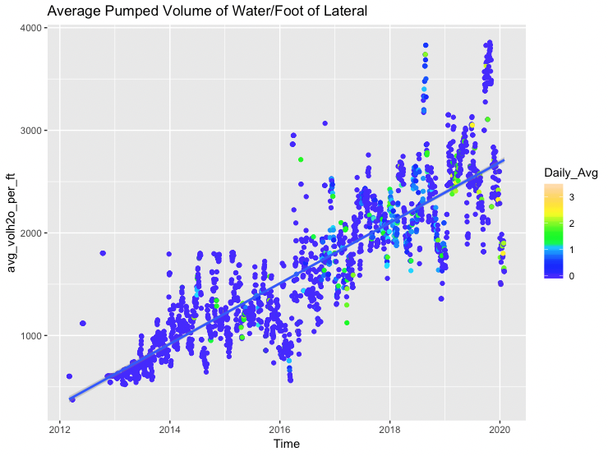
EDA: completions (fracs) have gotten bigger over time
All 3 Catalogs- For Historical Context
Notes:
This plot is showing the same information as the previous slide, but I included all three catalogs here to show more historical data. Note that this plot goes back to 2012, whereas the previous two only went as far back as 2016. The trend holds here as well.

Slide 12
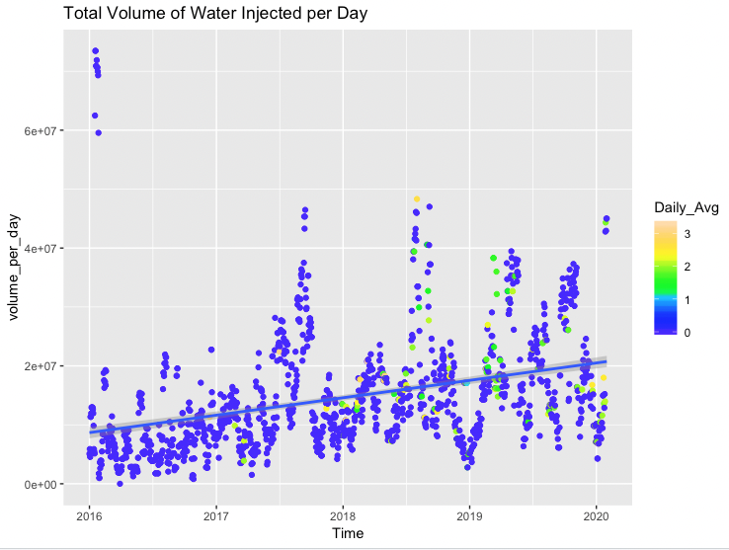
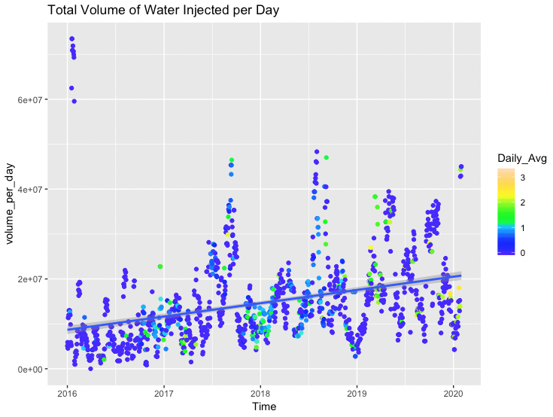
Again, completions have gotten bigger over time
USGS + TexNet Dataset
Fasola et al + TexNet Dataset
USGS catalog
TexNet catalog
Fasola catalog
TexNet catalog
Fasola et al catalog has time range 3/2014 - 12/2018

Slide 13
ARIMA/SARIMA Models
Different Features
Different Targets
Daily Average Magnitude
Daily Sum of Magnitudes
Daily Count of Events
Used AIC and RMSE as metrics
Resampled to Weekly Data
Modelled each Catalog
Notes:
Now onto the modelling. I experimented with both ARIMA and RNN models, so I’ll briefly speak to each. I tested different features and targets in the ARIMA modelling and used AIC (Akaike Information Criterion) and RMSE metrics to score. I resampled the data to weekly average as I had too much data to model the daily information, and I modelled using each of the three catalogs.

Slide 14
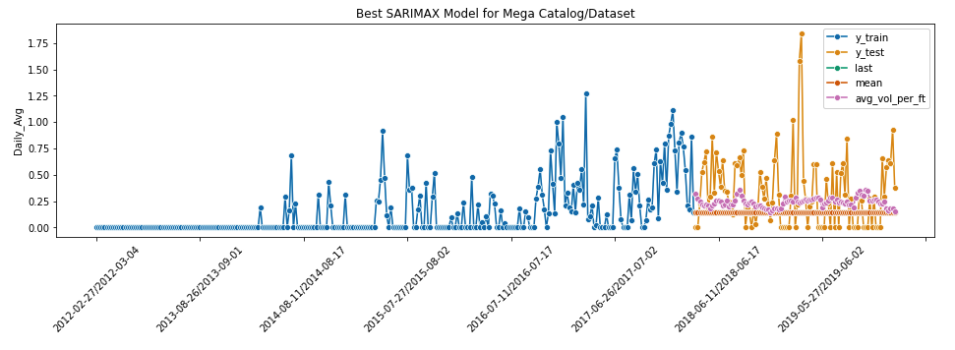
Best ARIMA model Results
Parameters: ARIMA(1,0,1)(0,0,0)
AIC: -118
RMSE: 0.36 (null rmse=0.38)
Best Target: Daily Average Magnitude
Best Features: Avg Volume/FT Lateral
Best Dataset: Mega (All 3 catalogs)
Notes:
The best of the ARIMA models used a Daily Average Magnitude as the target and the Average Volume/Ft lateral was the most telling feature. The best model is shown here in purple and performed .02 better than the null model (using the mean). Using all three catalogs together yielded this best model.

Slide 15
RNN Models
Different Features
Different Targets
Daily Average Magnitude
Daily Sum of Magnitudes
Daily Count of Events
Used Accuracy and RMSE as metrics
Resampled to Weekly Data
Modelled each Catalog
Tested different architecture
Notes:
For the RNN modelling, I again tested different targets, different features, and experimented with all three catalogs. I used accuracy and RMSE as the metrics for scoring against the null/baseline models. I also resampled to weekly average as well, and experimented with different model architecture.

Slide 16
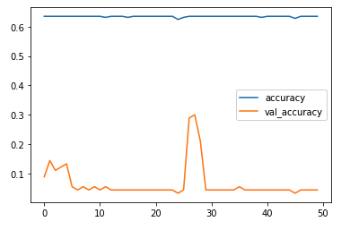
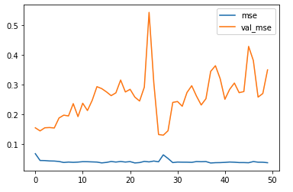
Best RNN model Results
Train vs Test Accuracy
Architecture: Multiple GRU layers & dropout
Accuracy: up to 30% for test accuracy
Test RMSE: 0.12 (null rmse=0.34)
Best Target: Daily Average Magnitude
Best Features: All except Brent Crude Spot Price
Best Dataset: Mega (All 3 catalogs)
Train vs Test RMSE
Notes:
The best RNN model didn’t have a very high test accuracy, only ~30%, but the RMSE was significantly lower than the baseline mean model, making it a success. Again, the best target was Daily Average Magnitude, and surprisingly most of the exogenous features contributed to this model, with the exception of Brent Crude. And again, using all three catalogs contributed to the best model, I think in large part for having the widest time range and the most data to train on.

Slide 17
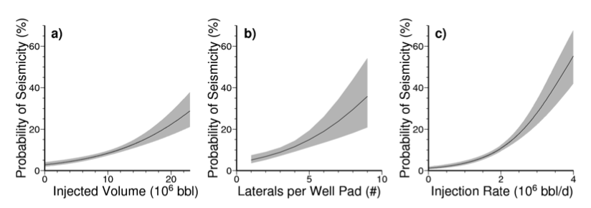
What does it all mean?
Likely a relationship between injection volume and induced seismicity, supported by findings in Fasola et al 2019
Figure 4. Fasola et al 2019
Notes:
So what does it all mean? Although my models weren’t exemplary, I do think there is a link between injection volume and seismicity. This hypothesis is supported in the reference publication as well, where Fasola et al show that the highest probability of seismicity is related to the overall injection volume and rate.

Slide 18
Conclusions & future work
Likely a relationship between injection volume and induced seismicity (despite poor-ish model results)
Future Work
Do more modelling with Daily Average as target
Experiment with ARIMA/SARIMA variations
Test ObsPy library for template matching to enhance my own catalog
Use lat/long information of completion vs events to model # fracs/sq mi
Try out Hidden Markov Models, Ensemble modelling
Dig into the 2018 seismicity more: what is different about the completions then?
Notes:
So, in conclusion, I think this is the start of a bigger project, as there is much more to explore. With every passing day I added more items to the list of future work. These are just some of the things I’d like to tackle, but this list is not exhaustive by any means….

Slide 19
references
S.L. Fasola, M.R. Brudzinksi, R.J. Skoumal, T. Langenkamp, B.S. Currie, K.J. Smart, “Hydraulic Fracture Injection Strategy Influences the Probability of Earthquakes in the Eagle Ford Shale Play of South Texas” Geophysical Research Letters, Vol. 46, Issue 22, 2019, pp. 12958 - 12967.
Notes:
Any questions?

Slide 20
Backup slides

Slide 21
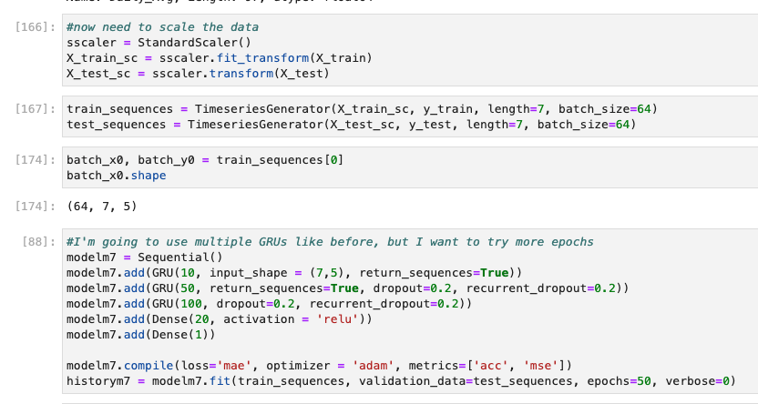
Best rnn model architecture

Slide 22
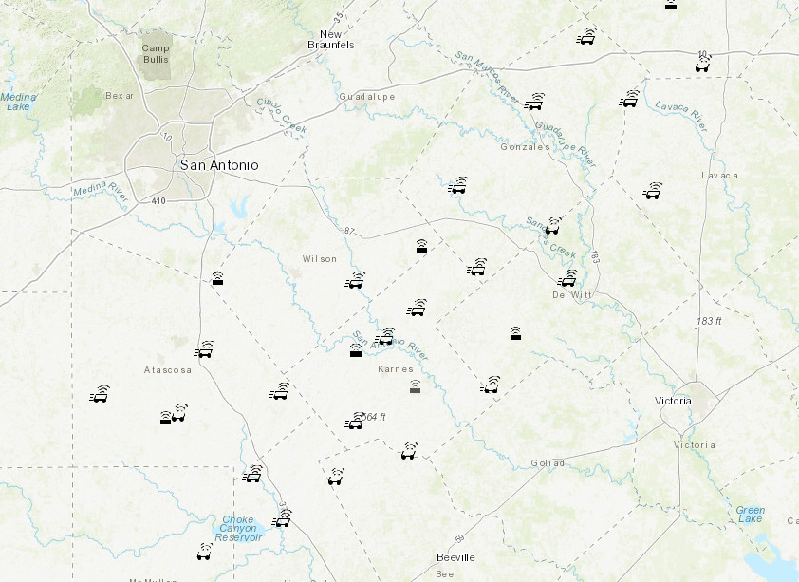
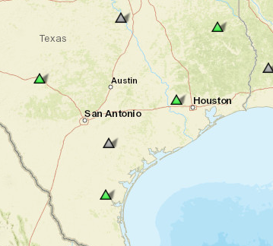
TexNet array vs usgs array
TexNet Array: ~30 Stations
USGS Array

Slide 23
Eagle ford shale play
Cretaceous-aged shale
One of world’s most prolific source rocks
Drilled since ~2002 (likely longer)
Focusing on Karnes County for this study
Map courtesy of eaglefordshale.com

Slide 24
